Slide 1
Creating a Practical Social Media Strategy for Authors, Customers, and Colleagues: A SAS Publishing Case Study
Sean Gargan & Kirsten Hamstra

Slide 2
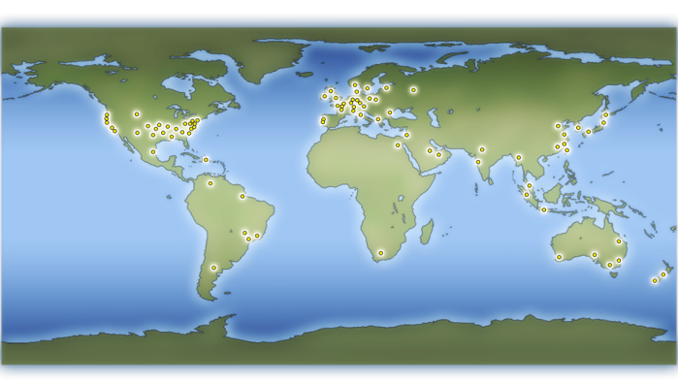
About SAS
Our Company
The leader in business analytics software and services, delivering THE POWER TO KNOW®
$2.31 billion worldwide revenue in 2009; an unbroken track record of revenue growth every year since 1976
Continuous reinvestment in research and development, including 23% of revenue in 2009
Ranked No. 1 on FORTUNE magazine’s 2010 “100 Best Companies to Work For” list
More than 11,000 employees, 400 offices and 600 alliances globally
Notes:
2

Slide 3
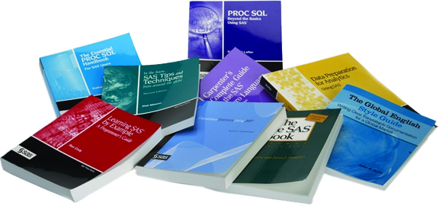
Who We Are
SAS Publishing provides a complete selection of books and electronic products to help customers use SAS software to its fullest potential.

Slide 4
The Challenge
Research the social media landscape
Understand your audience
Determine goals and objectives
Develop a strategy

Slide 5
Social Media Landscape
Lesson #1
rethink your organizational structure and job roles
Identify social media channels
Research
  B2B trends
  How other companies use each channel
  Profile users
  Identify opportunities
Take action
Social media represents a fundamental shift
in the way we market, sell, and interact
with our prospects and customers.

Slide 6
Question: Which of the following Web sites do you visit to network with professionals?
2008: n= 533 2009: n=265
Other sites were not included in the 2008 survey.

Slide 7


SAS has many fans in need of nurturing
Community | SAS Groups
 | >100
 | >30
support.sas.com | 14 forums
sasCommunity.org | 9 forums
Lesson #2
become familiar with your customers’ social media habits

Slide 8
Our Goals
Raise awareness of SAS Publishing among internal and external stakeholders
Build community for our customers to interact with staff, authors and SAS experts
Generate leads for new marketing campaigns
Increase sales of SAS Publishing’s line of products

Slide 9
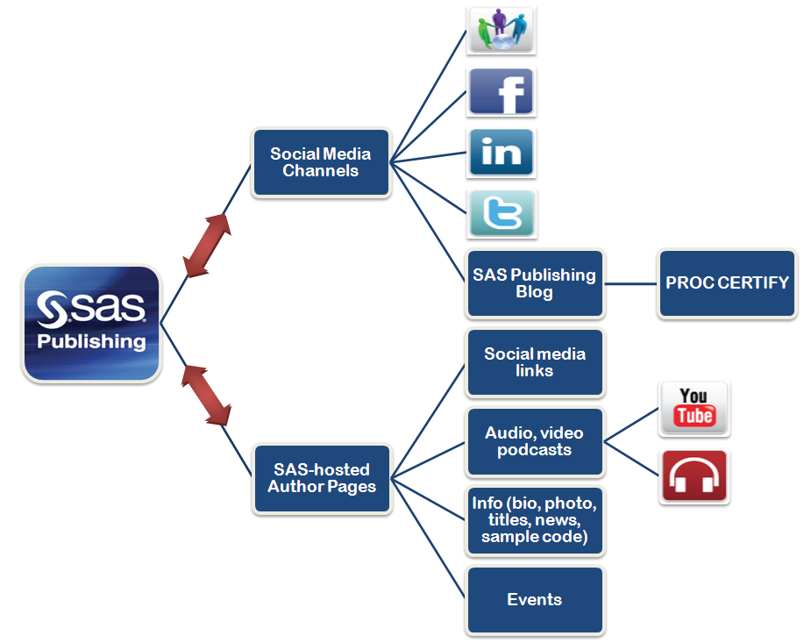
Strategy Development

Slide 10
Implementation
Define your presence
Create and manage content
Monitor and measure efforts

Slide 11
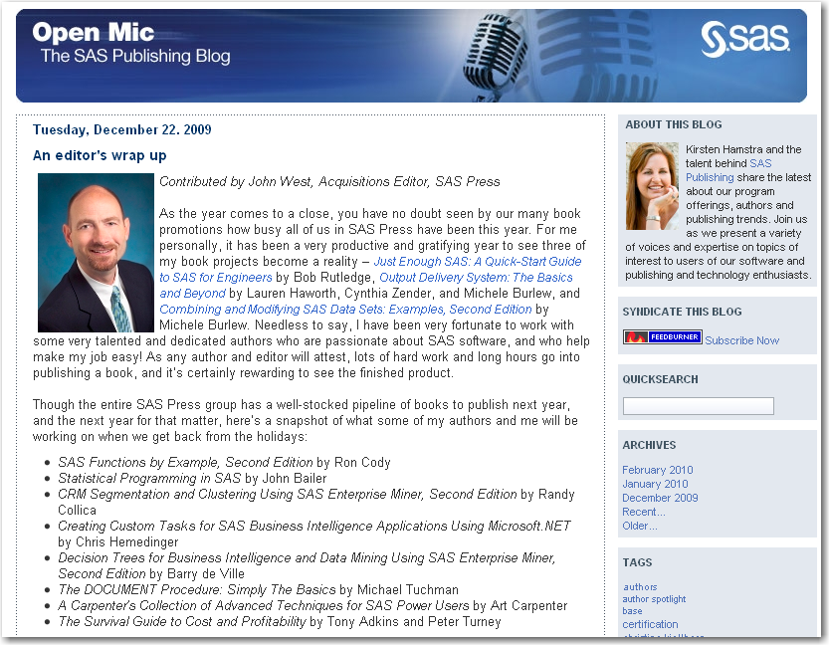
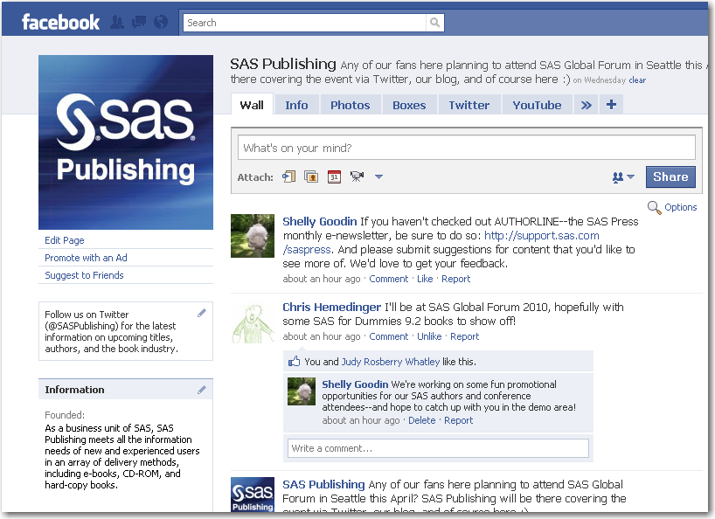
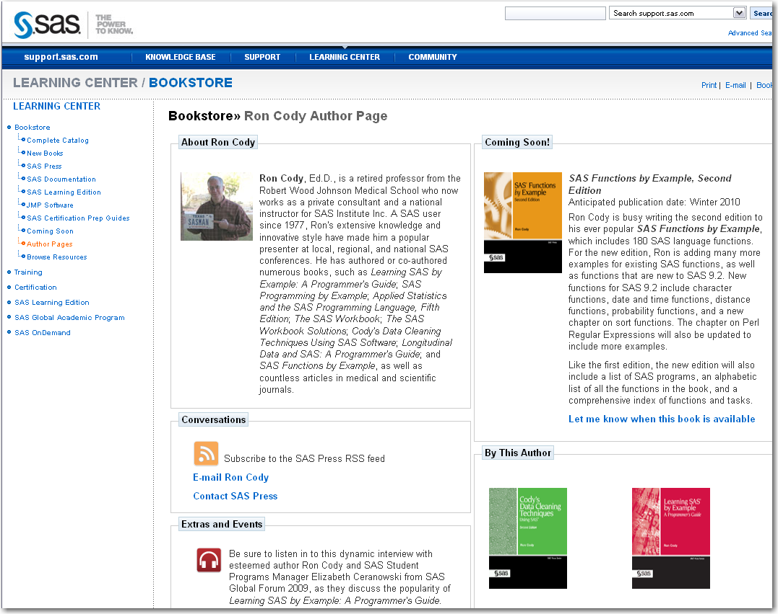
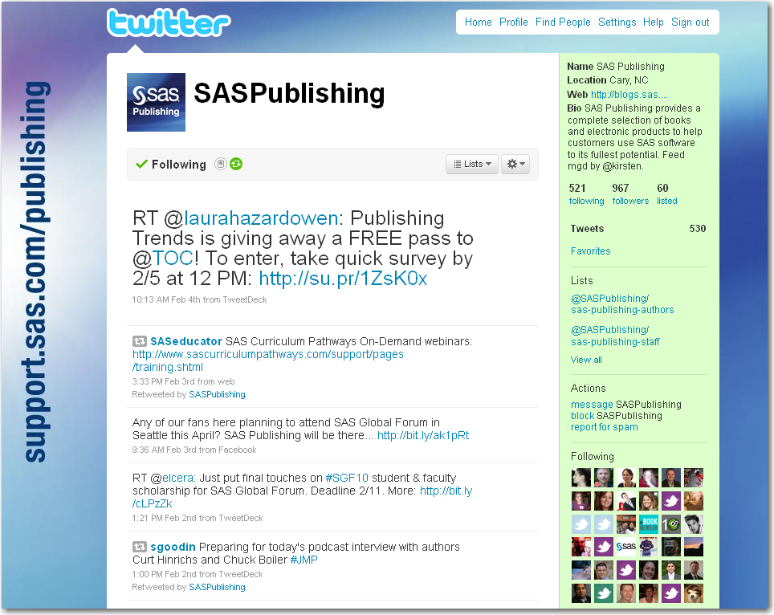
Brand Consistency
Lesson #3
be consistent wherever you build a presence

Slide 12

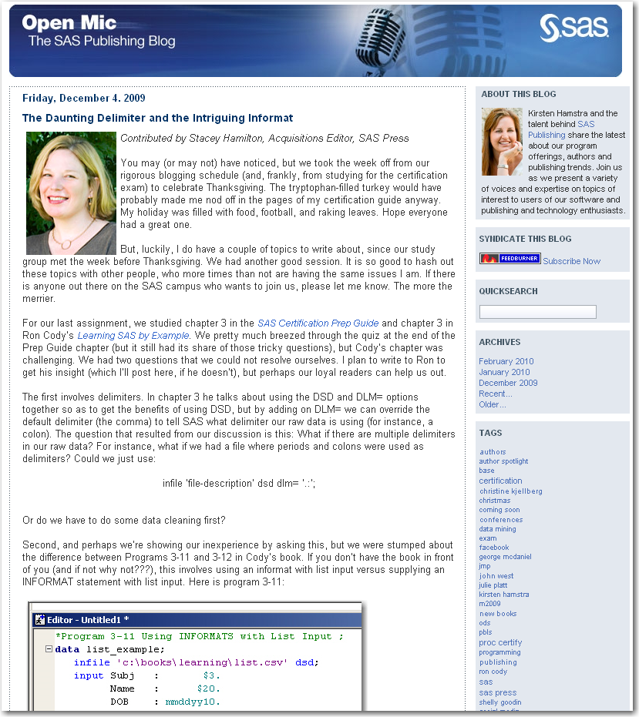
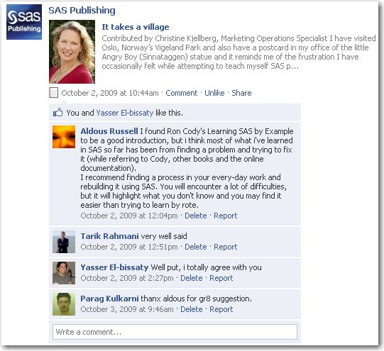
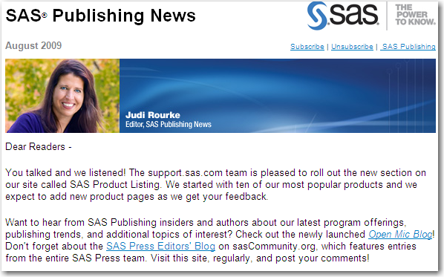

Feature Content: PROC CERTIFY
Lesson #4
hook your audience with an ongoing feature

Slide 13
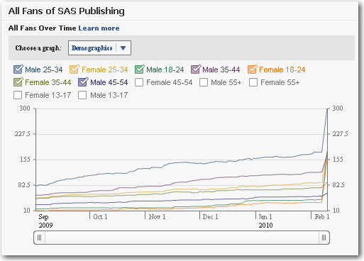
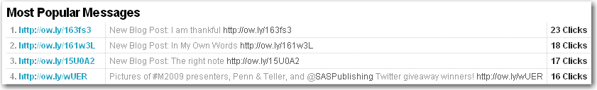
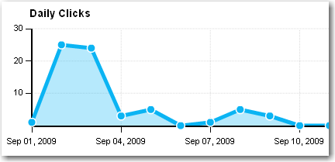
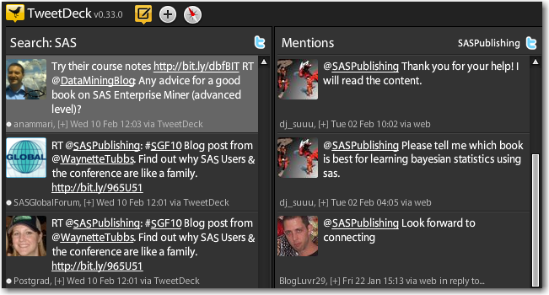
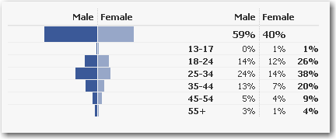
Monitor & Measure

Slide 14
Marketing
Internal
External
Integrated mix

Slide 15
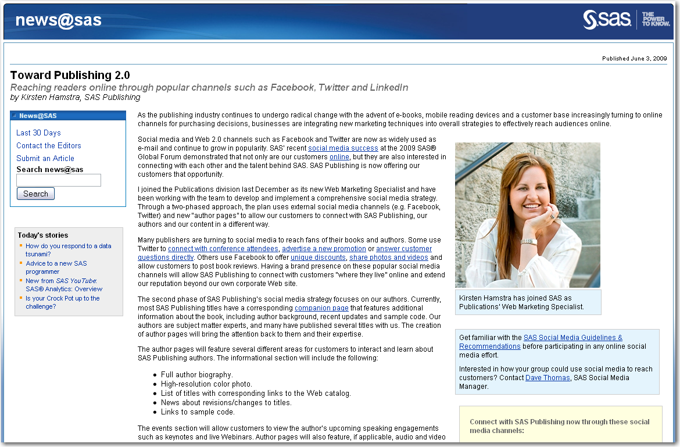


Internal Marketing
Lesson #5
build an informal network of colleagues and cross-promote

Slide 16
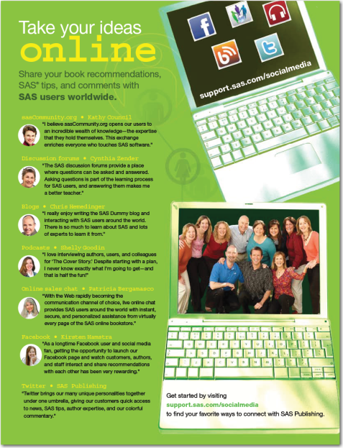
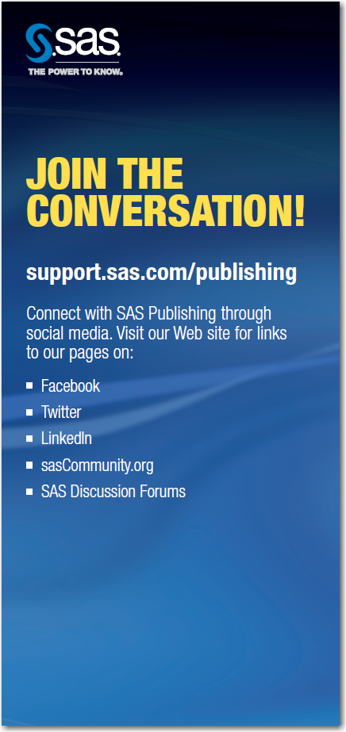
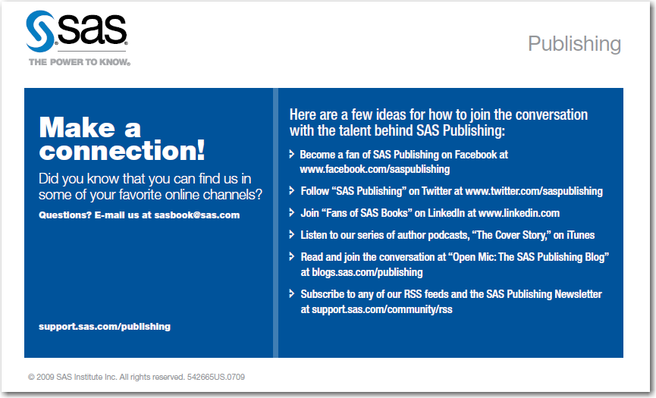
Traditional Media Marketing
Lesson #6
integrate social media into
existing collateral

Slide 17
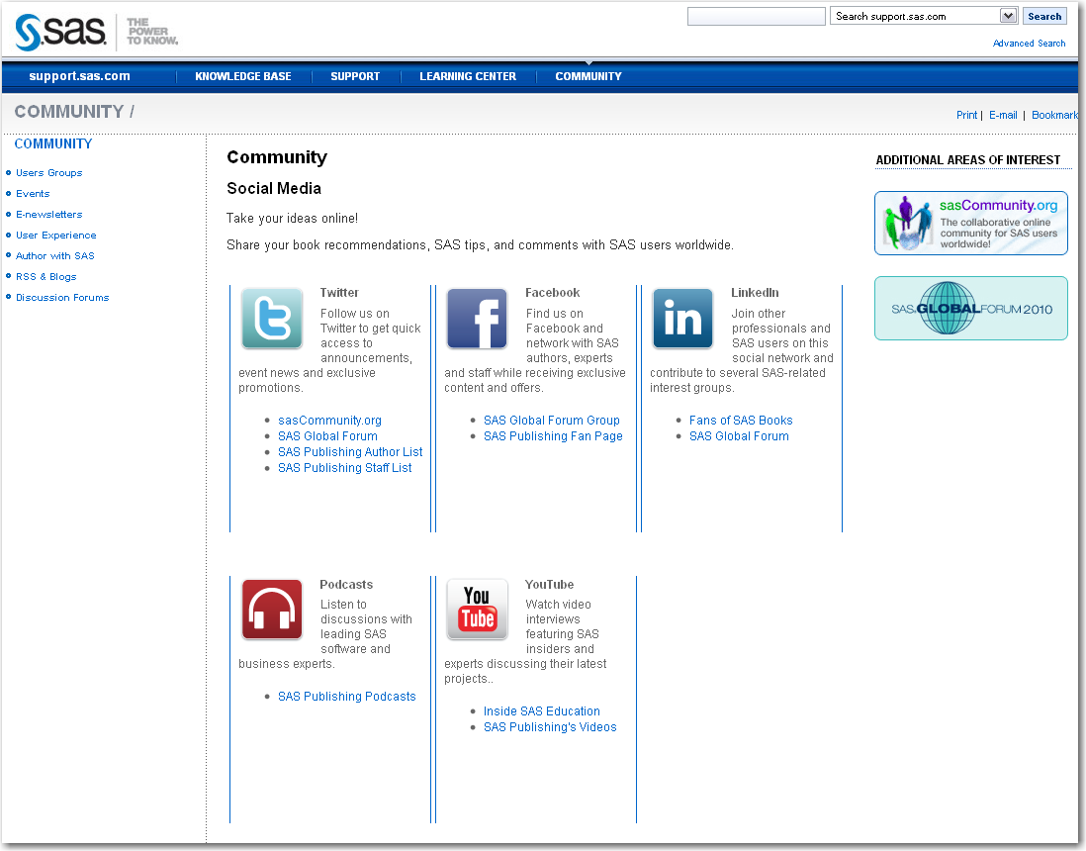
Central Landing Page

Slide 18

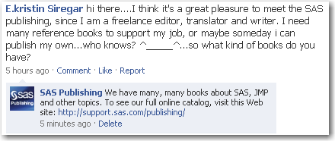
New Media Marketing
420% increase in fans
7-day run
≈ 25,000,000 impressions
Ad spend < $1500
Targeted friends of current fan base in top countries

Slide 19
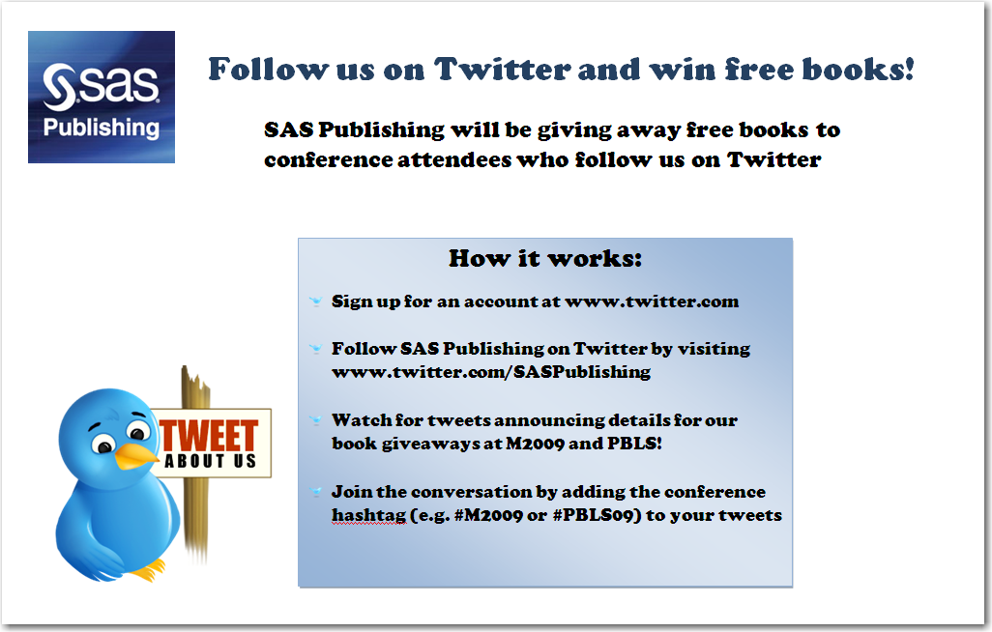
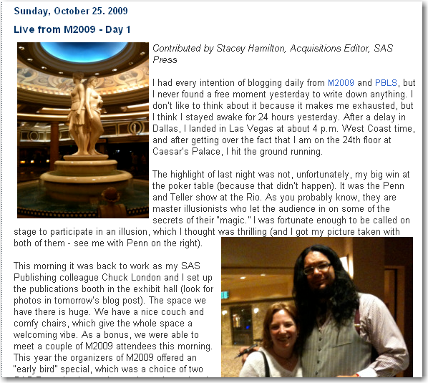
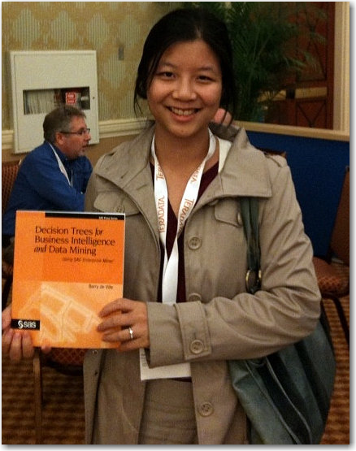
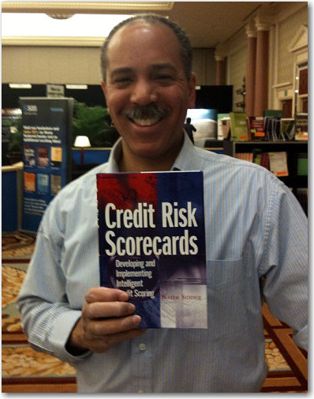
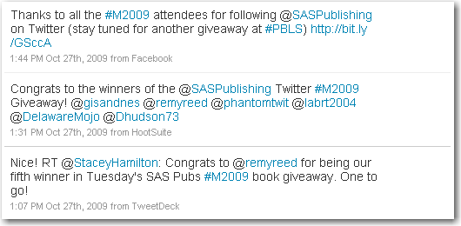
A Powerful Combination
Lesson #7
use social media to make 1:1 connections with customers

Slide 20
Help Each Other
Customers
Co-workers
Authors

Slide 21
Customers
Lesson #8
educate your audience in
social media 101

Slide 22
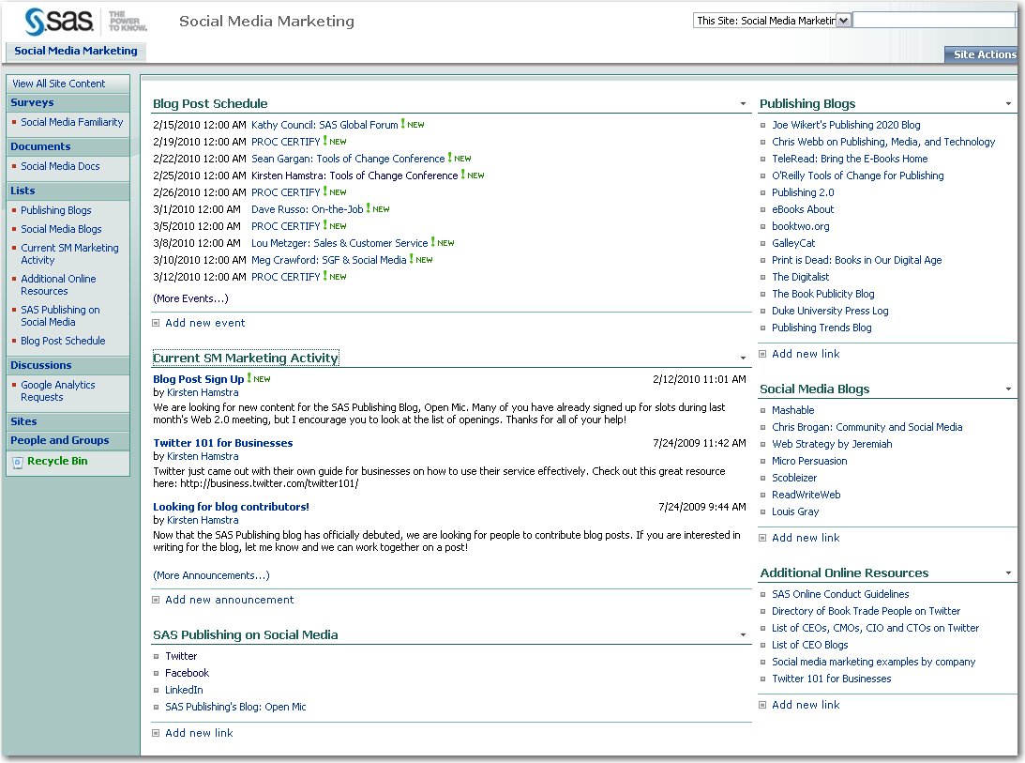
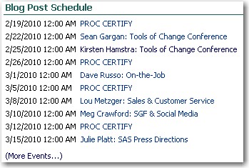
Co-workers
Lesson #9
don’t be shy to ask (or beg) your
colleagues for content

Slide 23
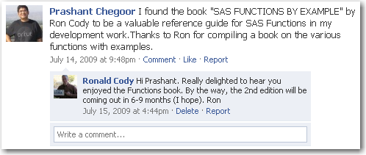
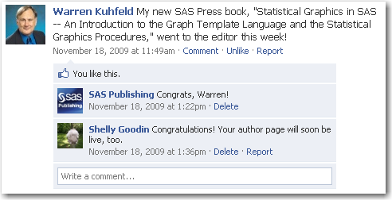
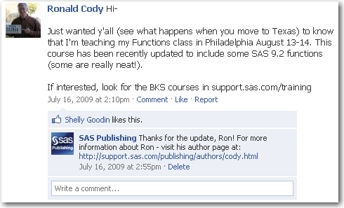
Authors
Lesson #10
Don’t Assume your authors know how to use facebook or Twitter

Slide 24
10 Lessons Learned
Rethink your organizational structure and job roles
Become familiar with your customers’ social media habits
Be consistent wherever you build a presence
Hook your audience with an ongoing feature
Build an informal network of colleagues and cross-promote
Integrate social media into existing collateral
Use social media to make 1:1 connections with customers
Educate your audience in Social Media 101
Don’t be shy to ask (or beg) your colleagues for content
Don’t assume your authors know how to use Facebook or Twitter

Slide 25

Visit blogs.sas.com/publishing
to see a list of our lessons learned
and to comment by adding your own
Follow Our Progress
support.sas.com/publishing
twitter.com/SASPublishing
facebook.com/SASPublishing

Slide 26

Copyright © 2009, SAS Institute Inc. All rights reserved.

